Slide 1
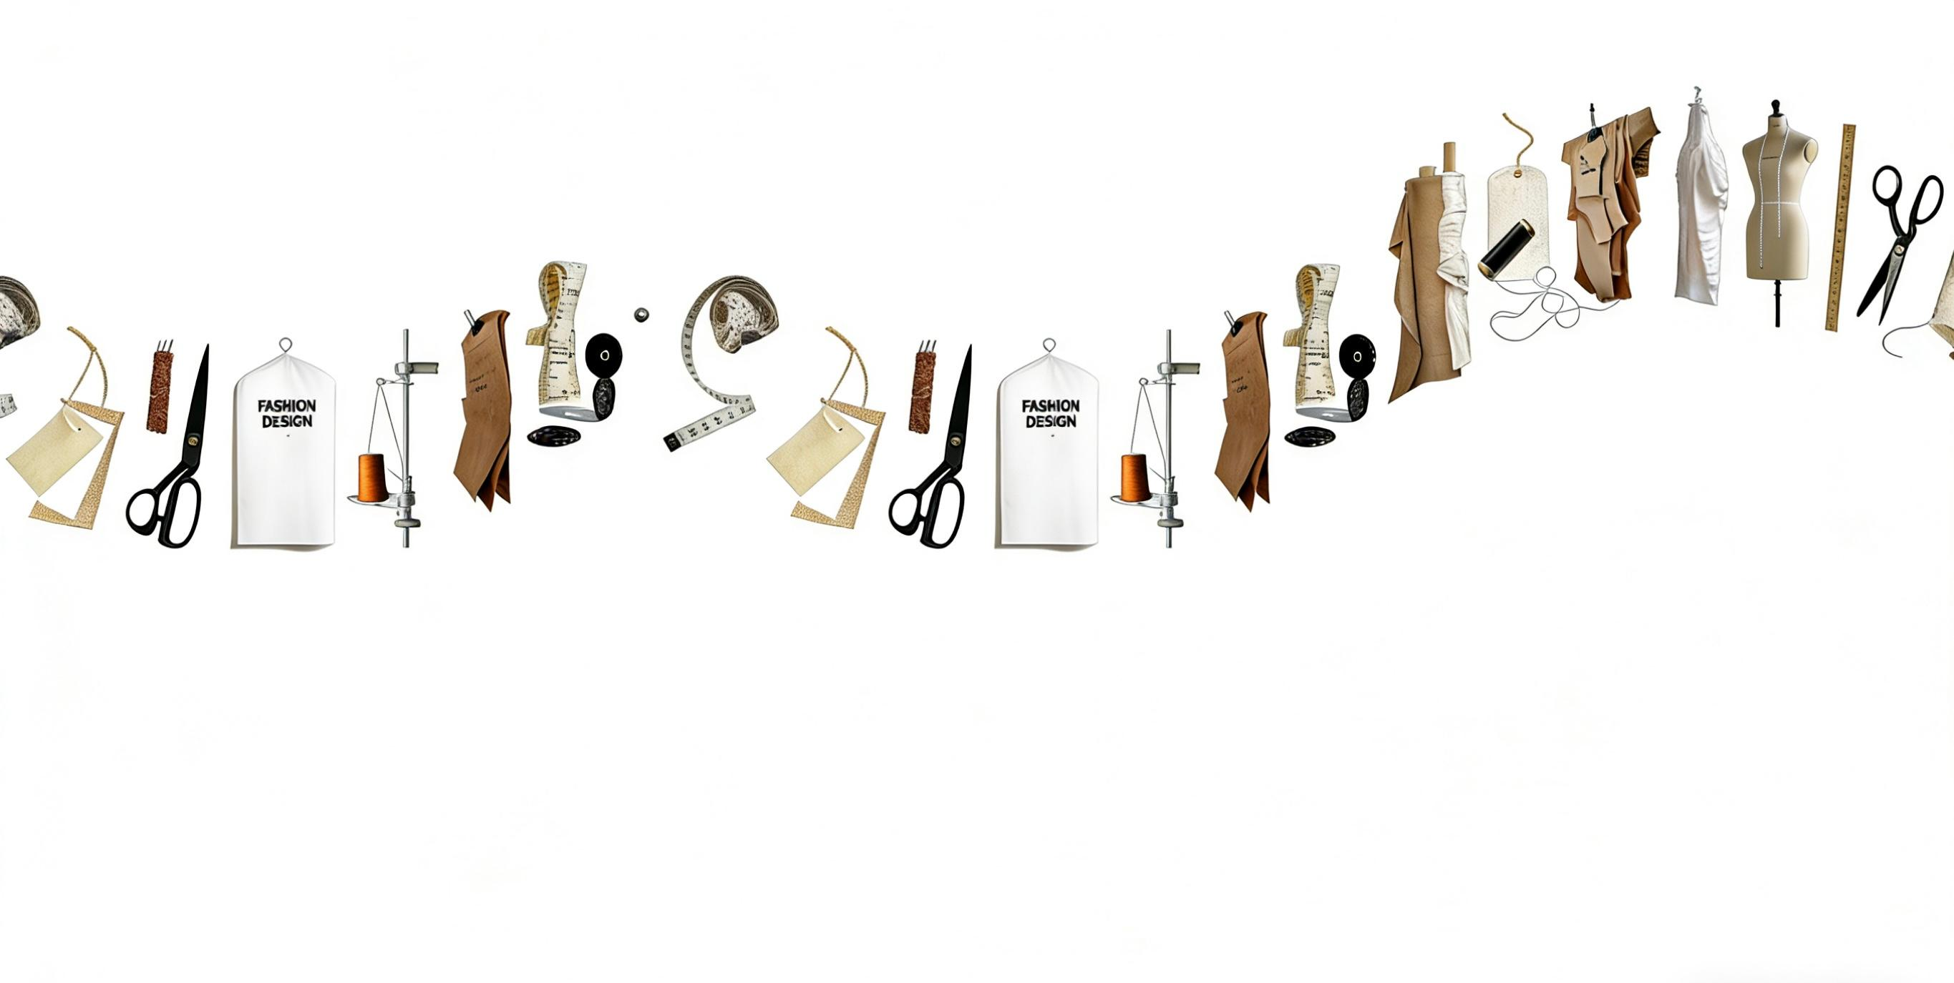


Slide 2
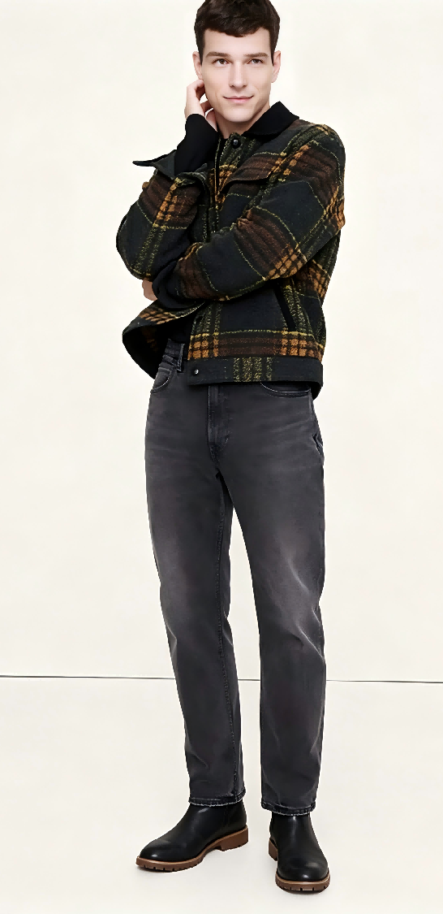
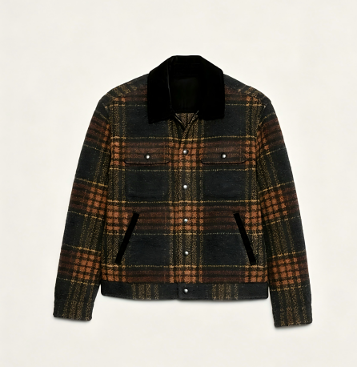
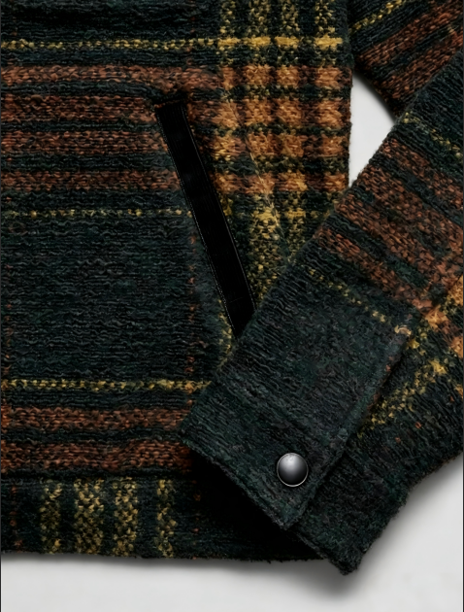
SAMPLE REF NO.: JT-W-2711
FABRIC COMP: 59%Wool,41%Polyester(For reference only)

Slide 3
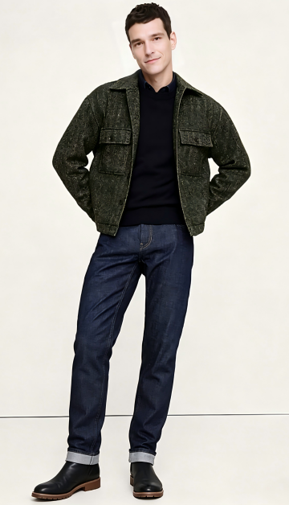
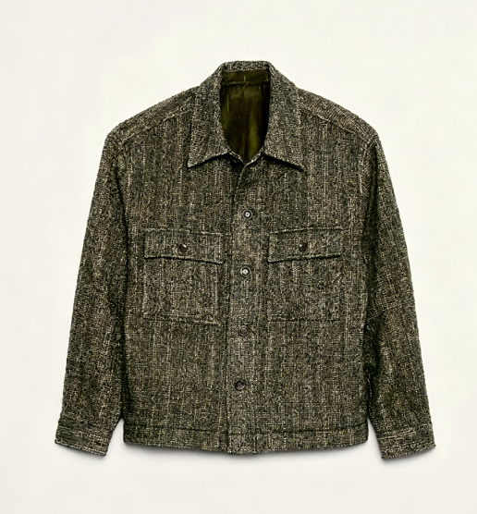
SAMPLE REF NO.: JT-W-2712
FABRIC COMP: 60%Polyester 40%Wool (For reference only)

Slide 4
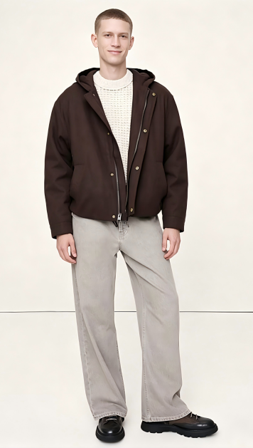
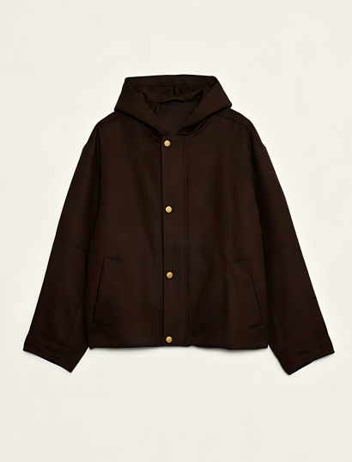
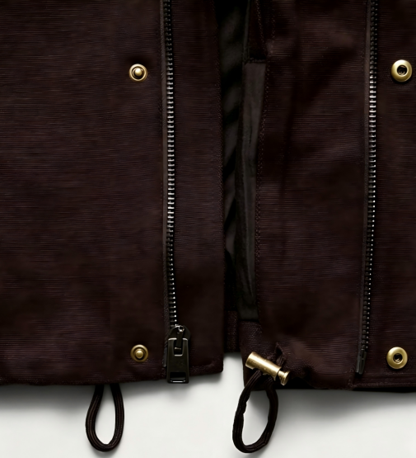
SAMPLE REF NO.: JT-W-2713
FABRIC COMP: 55%Hemp 45%Cotton (For reference only)

Slide 5
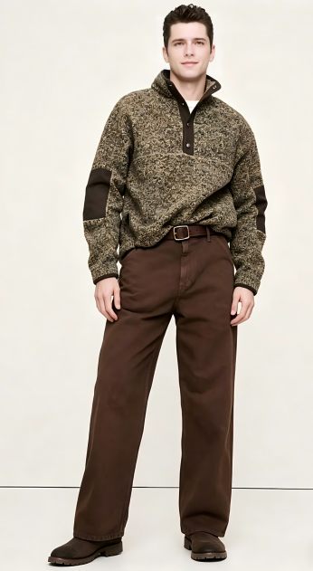
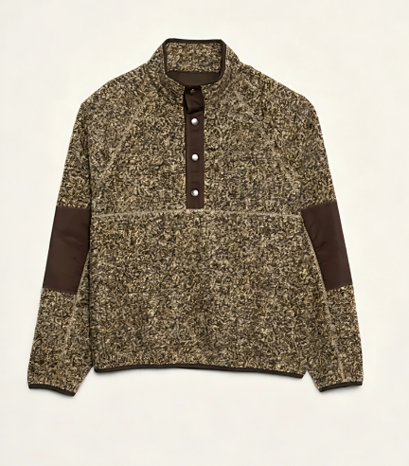
SAMPLE REF NO.: JT-W-2714
FABRIC COMP: 52%Polyester 39%Viscose 7%Nylon 2%Spandax(For reference only)

Slide 6
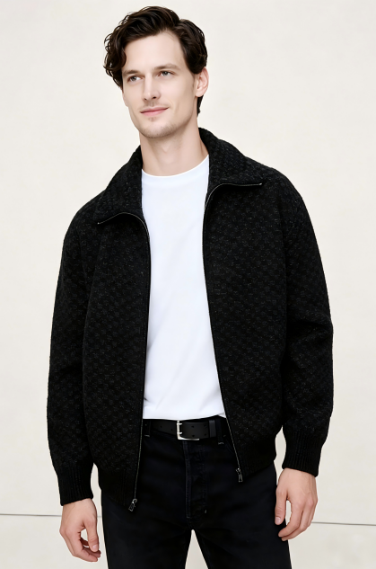
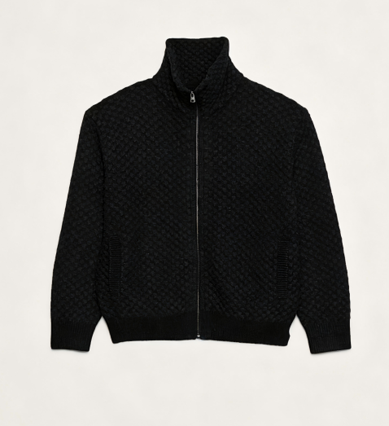
SAMPLE REF NO.: JT-W-2715
FABRIC COMP: 44%Nylon 34%Polyester 22%Wool(For reference only)

Slide 7
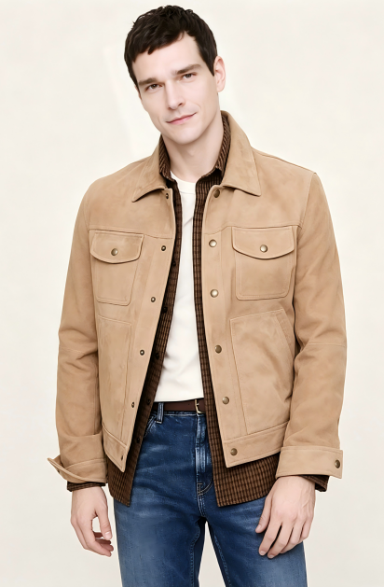
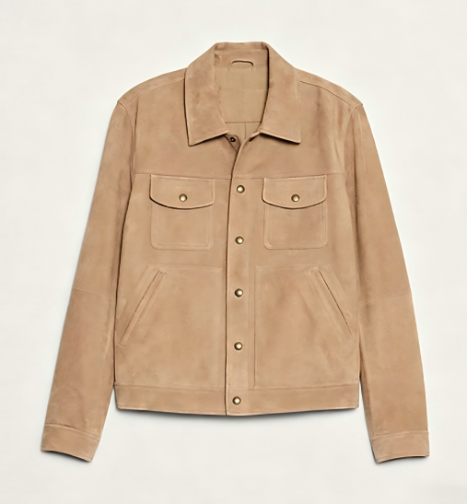
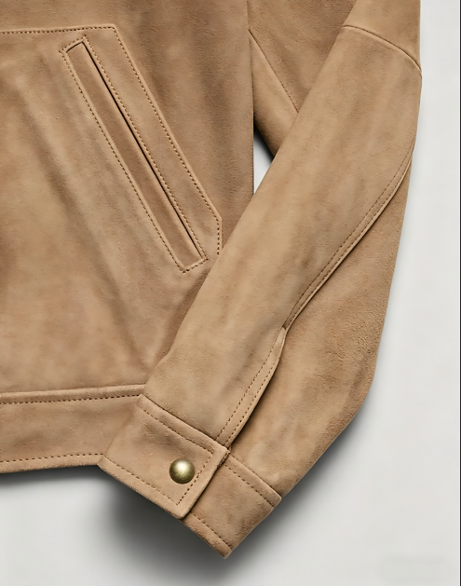
SAMPLE REF NO.: JT-W-2716
FABRIC COMP: 100%Suede(For reference only)

Slide 8
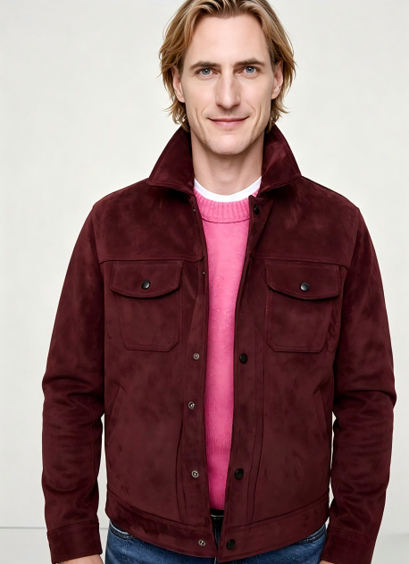
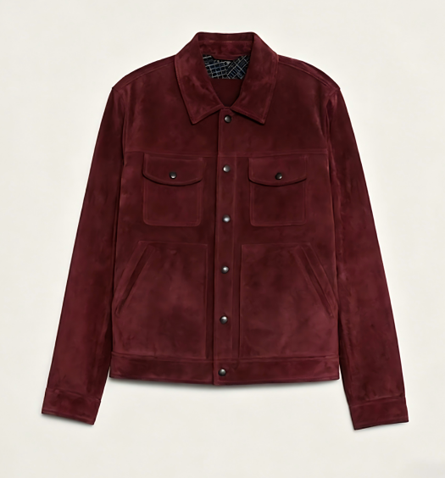
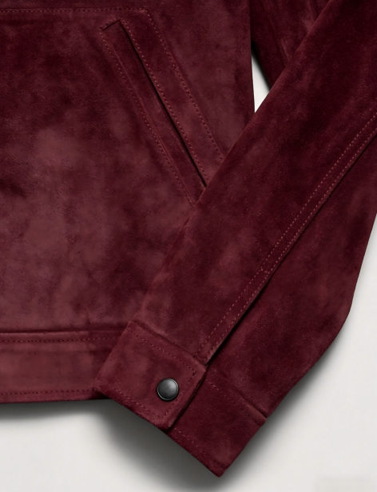
SAMPLE REF NO.: JT-W-2717
FABRIC COMP: 100%Suede(For reference only)

Slide 9
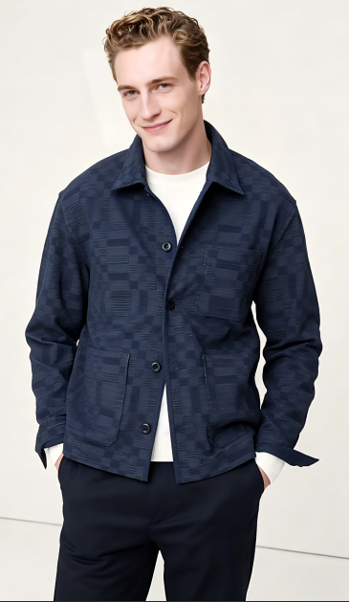
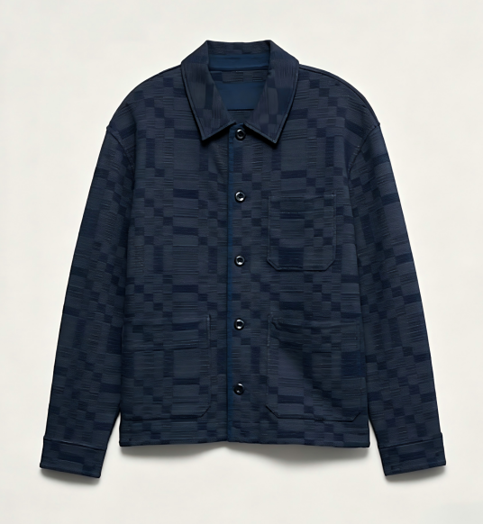
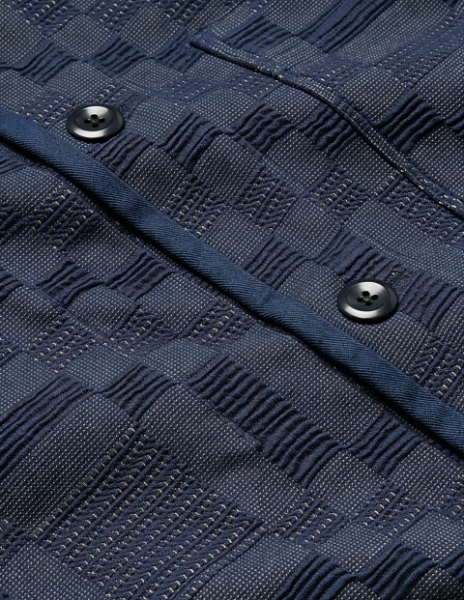
SAMPLE REF NO.: JT-W-2718
FABRIC COMP: 67%Cotton 31%Polyester 2%Spandax(For reference only)

Slide 10
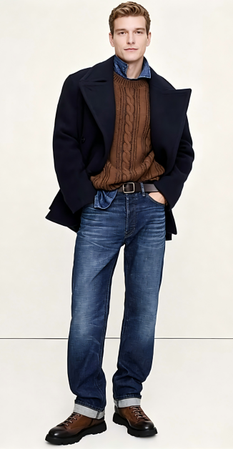
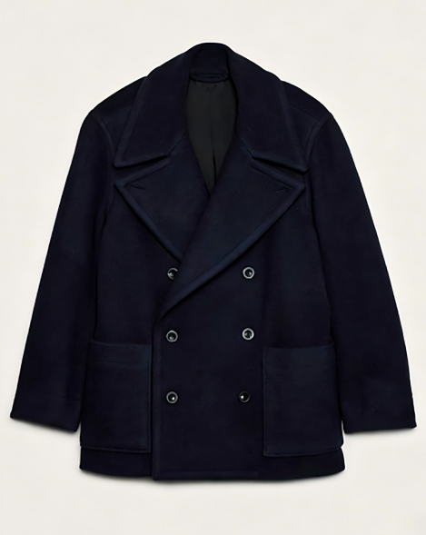
SAMPLE REF NO.: JT-W-2719
FABRIC COMP: 75%Polyester 15%Viscose 8%Wool 2%Elastane(For reference only)

Slide 11
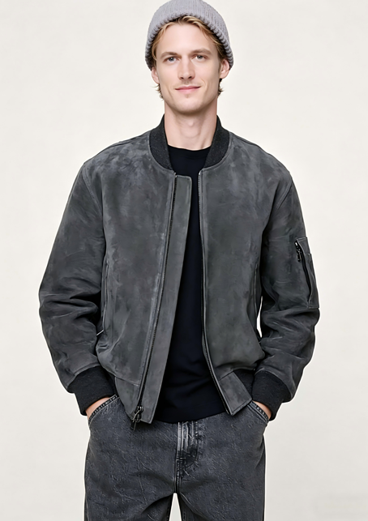
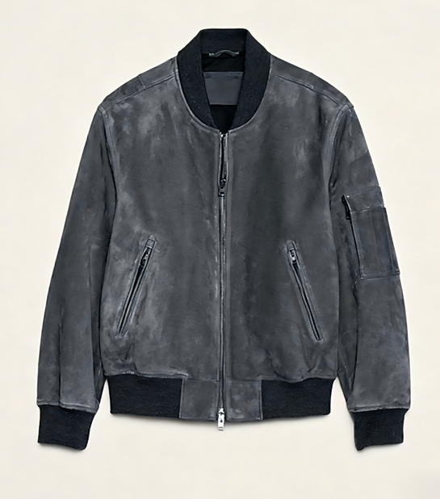
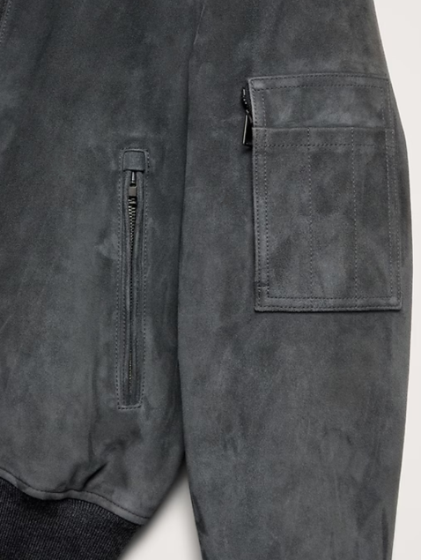
SAMPLE REF NO.: JT-W-2720
FABRIC COMP: 100%Suede (For reference only)

